Slide 1
Introduction to Servlet
Index.html
Servlet
Request
Abc.html
Response
html page
Helper Application
(Web Container)
Client
Tomcat
Deployment Descriptor
(web.xml)
Server
How Servlet works -> Client sends a request to server -> Server sends back the data in response in HTML/Jason format to the client
The Request could be for Static page or Dynamic page. For Static page the server already has the page and can send it to client. But for Dynamic page the Server does not have it and
needs to build it @runtime .
Server takes the help of a Helper Application known as Web Container. In this Web Container we will be having Servlets
This servlet will process the request by fetching data, preparing the data for presenting to client in form of HTML page
Web Containers are Apache Tomcat, Jboss, GlassFish, IBM Websphere -> these are app servers which also has features of Web Servers (Requests and Responses)
Web Container finds Abc.html is to be built dynamically so it will call Servlet (a Java program) , that is the request is diverted by Tomcat to Servlet
When a request calls Abc.html, a page which should be getting called is Servlet (through Tomcat)
Inside the container (Tomcat) there is a special file “web.xml” called deployment descriptor in which we mention for which request which servlet is called
In web.xml we have two tags -> Servlet & Servlet Mapping tags. Servlet tag mentions the Class name & Servlet Mapping tag mentions the URL mapping
Servlet is a normal class (Plain Old Java Object – POJO) which extends HttpServlet class – this HttpServlet gives all the features needed for a web application
Response object built by Servlet goes to Client in form of XML / Jason. But to avoid XML response Servlet version 3.0 provides annotations like @WebServlet(“/abc.html”)

Slide 2
Eclipse setup & tour
IDEs
Eclipse
NetBeans
Intellij
For Eclipse
Eclipse -> google -> eclipse download -> Eclipse IDE for Java EE… -> Download links -> Windows 64-bit -> download the zip -> Select a Workspace
Workspace is a folder where all your project details are stored eg: d:/debasis/workspace/servlet
Inside Eclipse
Markers || Properties || Servers || Data Source Explorer || Snippets
Markers tab helps to debug the code, whatever issues will be displayed in this tab
Servers tab is important as we need a server (Web Container/ Servlet Container) for a Servlet to run on it,
Data Source Explorer tab – for all the database related details like connections,
Select Java EE as perspective – Java EE gives the configuration for Servers
If servers tab is not available use –
Window -> Show View -> Servers

Slide 3
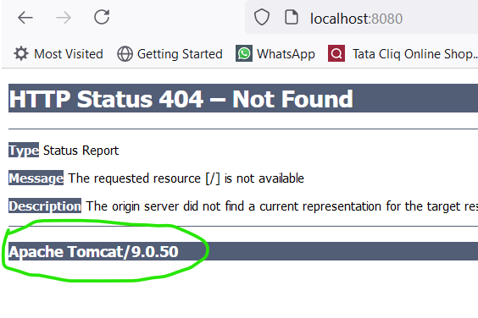
Configure Tomcat in Eclipse
Download Tomcat
Browser – tomcat download -> Apache Tomcat – Apache Tomcat 8 Software Download -> select 8.0.48 -> 64-bit Windows zip
-> Source Code distributions zip
Servers tab -> Once Tomcat is downloaded there is a link in Servers tab to create a new server -> Define a new Server window opens
-> Apache Server Type -> select Tomcat 8.0 server -> provide the Tomcat Installation directory: -> finish
Make sure Tomcat Server is started -> double click on Tomcat 8.0 server to start / right click on server -> select Start
In some cases the Tomcat server might not start up – double click and check the port number and change it as other application might be using 8080 service port
Check if Tomcat is working :
1. Ensure the server is started 2. Browser type “localhost:8080” 3. Tomcat page is not displayed but one can see Tomcat is working
4. to get the Tomcat Index page -> double click tomcat server is Servers tab -> Server Locations -> change the radio button from “Use workspace metadata” to “Use Tomcat Installation” -> Save config -> restart the Tomcat Server
5. Repeat step 2
6. You should get the Tomcat Index page

Slide 4
Eclipse & Tomcat Setup in Windows
Download Eclipse
Browser – eclipse ee download -> Eclipse IDE for Java EE Developers | Packages -> Oxygen Packages -> Eclipse IDE for Java EE Developers -> Windows 32-bit 64-bit -> Download
Tomcat Download -> Refer to page 3
After Eclipse download -> Extract -> Open Eclipse from the extracted directory -> Assign an Eclipse workspace (Workspace is the eclipse directory to store its preferences and development artifacts) -> Launch -> Opens Eclipse

Slide 5
Creating Web Project in Eclipse
Right click on left navigator -> new -> Other -> Select a wizard -> Under Web folder select Dynamic Web Project -> Next -> Project Name , Project Location -> Finish
OR
File -> new -> Dynamic Web Project -> Project Name , Project Location, Target Runtime (is the Tomcat version installed) , Dynamic web module version (select the latest version 4.0 for servlet) -> next -> next -> tick on Generate web.xml deployment descriptor -> Finish
So your first project is created
Project Folders
---------------------
WebContent /
Webapp
Java Resources -> src -> main -> java (Java Servlet source codes path)
Creating an web page displaying Hello world -> Right click on project -> new -> HTML file
Creating an Index.html page: will be created under Webapp
META-INF
WEB-INF
web.xml
(The most important file – deployment descriptor)

Slide 6
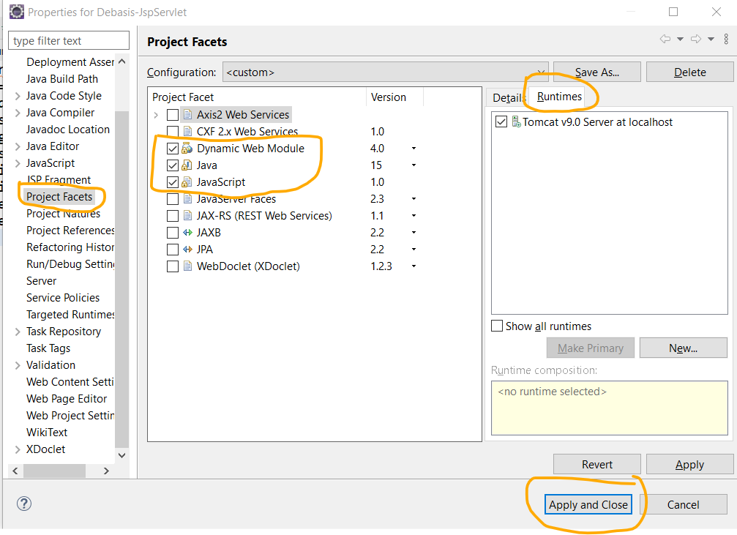
HttpServlet issue in Java Build Path in Eclipse
Error:
The superclass “javax.servlet.http.HttpServlet” was not found on the Java Build Path in Eclipse
Problem Statement :
If you are facing this error after importing an existing maven project/ Dynamic Web project into eclipse IDE, then it means that http-servlet is not available in the project’s class path and you must include it.
Solution:
To include http-servlet into your class path, you have two options:
1) Add target runtime
In this solution, you can add desired server runtime into your application as project facet. Right Click on Project -> Properties -> Project Facets -> Check the “Dynamic Web Module” + “Java” + “JavaScript” -> Runtimes tab -> check the application server
2) Add maven dependency
Another option is to include the servlet dependency through maven itself.
This will also fix the error.
<dependency> <groupId>javax.servlet</groupId> <artifactId>servlet-api</artifactId> <version>2.5</version> </dependency> <dependency> <groupId>javax.servlet.jsp</groupId> <artifactId>javax.servlet.jsp-api</artifactId> <version>2.2.1</version> <scope>provided</scope> </dependency>

Slide 7
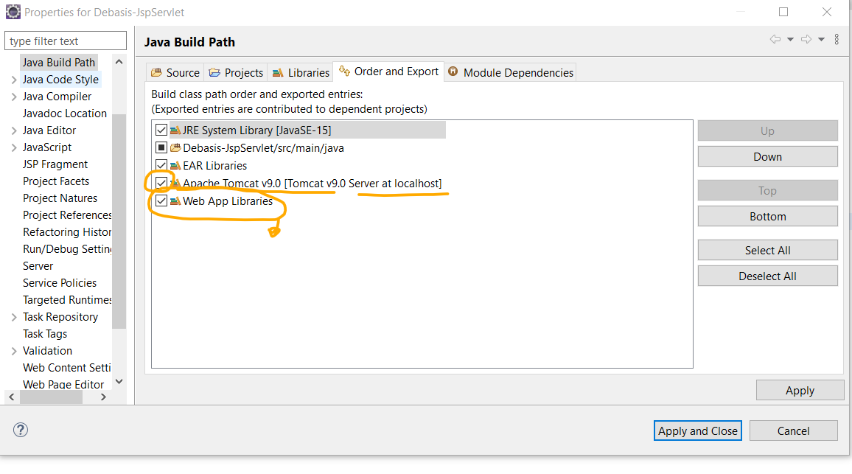
JavaDoc WebApp issues in Java Build Path in Eclipse
Error:
How to solve “This element has no attached source and the Javadoc could not be found in the attached Javadoc”?
Problem Statement :
When a Java Class or Interface is hovered over and CTRL+click for detailed declaration done there is no Javadoc description and the above error is displayed.
Solution:
right click on the Project>Build Path>Configure Build Path>order and Export > and bring Web App libraries to the bottom > Then Close the project and reopen it
Note: Remember to download Tomcat documentation Zip

Slide 8
HTTP – Hyper Text Transfer Protocol
Get
Post
Put
Delete
Options
7 methods of Http Protocol,
But normally 5 methods are used
Post is a preferred method over Get as in Get the browser displays the url?<query string>, whereas in Post it is only /url
This is good for security

Slide 9
RequestDispatcher & sendRedirect
req1, res1
x = 5
req1
req1, res1
rd.forward(req1, res1)
Request Dispatcher rd
S1 (Servlet)
S2 (Servlet)
res1
Hosted on same server (pcsglobal.com)
res1
Browser/Client
pcsglobal.com
x
req1
S1 (Servlet)
res1
x
sendredirect()
paypal.com
Session Management
Browser/Client
req2
S2 (Servlet)
res2
Hosted on separate servers

Slide 10
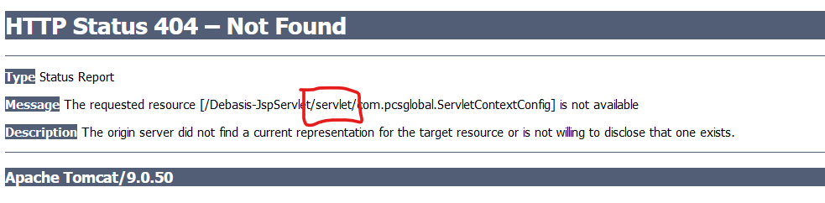
The requested resource ... Is not available
Error:
The requested resource …. Is not available. The origin server did not find a current representation for the target resource or is not willing to disclose that one exists
Problem Statement :
If you are facing this error that means you have either not include annotation @WebServlet(“/servlet”) in the class declaration, or the web container WEB.XML does not have the default <url-pattern>/servlet</url-pattern> mentioned along with the <servlet-name> & <servlet-class>
Solution:
For the error screen shot given here, WEB.XML solution should have the following declared:
<servlet>
<servlet-name>contextconfig</servlet-name>
<servlet-class>com.pcsglobal.ServletContextConfig</servlet-class>
</servlet>
<servlet-mapping>
<servlet-name>contextconfig</servlet-name>
<url-pattern>/servlet</url-pattern> // This is the default URL of the servlet.
</servlet-mapping>

Slide 11
How JSP is converted to Servlet?
JSP Servlet
demo.jsp package …
<html> import ….
<body> public class demojsp extends HttpServlet
<% This tag is called Scriptlet JSP tag demo.jsp get converted to a class demojsp {
int i = Integer.parseInt(request.getPara….); which extends HttpServlet public void service( req, res) ….
int j = Integer.parseInt(request.getPara….); {
int k = I + j; int i = Integer.parseInt(request.getPara….);
out.println(k); int j = Integer.parseInt(request.getPara….);
%> This tag will tell application server to convert the code into Servlet PrintWriter out = res.getWriter();
</body> int k = I + j;
</html> Servlet will provide Jsp with Request, Response, out objects out.println(k);
}
}
Declaration JSP tag
<%! %> → The declaration tag will declare variables and methods that will be instantiated outside the service() method of servlet, that is variable will be declared just after the class and before the service method, and the methods will be declared outside the service method → preferably only after service() method which should be the first method in a servlet
Directive JSP tag
<%@page import=“java.util.Date”, “java.sql.Statement” %> → This directive tag will help import library packages for JSP similar to as we use import before the Servlet class. Import is an attribute of Directive tag.
Expression JSP tag
<%= k %> → This expression tag will help print output from JSP page, similar to Servlet out.println(k).
Jsp gets converted to Servlet

Slide 12
JSP Directive | Page | Include | Taglib
JSP Directive →
@page @include @taglib
<%@ page attribute=“value” attribute=“value” … %> <%@ include file=“filename” %> <%@ taglib uri=“uri” prefix=“fx” %>
language=“scripting language” <%@ include file=“header.jsp” %> <debasis> -> this tag is unknown
Extends=“classname” <fx:debasis> -> this tag then belongs to “uri” lib
Import=“ImportList” having the definition of <debasis> tag
Session=“true | false”
autoFlush=“true | false”
contentType=“ctinfo”
errorPage=“error_url”
isErrorPage=“true | false”
Info=“Information”
isELIgnored=“true | false”
isThreadSafe=“true | false”

Slide 13
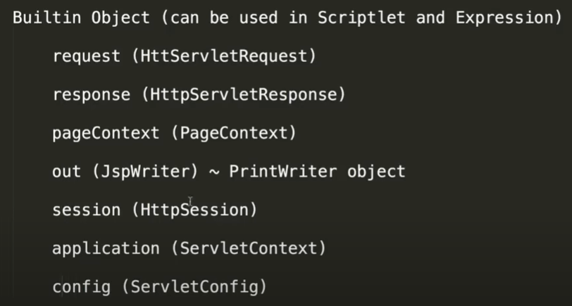
Implicit Object in JSP

Slide 14
JDBC in JSP
7 Steps of JDBC →
Import package (java.sql.*)
Load and register driver [ Class.forName("com.mysql.jdbc.Driver"); ]
Connect to mysql database [ DriverManager.getConnection(“jdbc:mysql://localhost:3306/jsp”, uname, pwd); ]
Creating the Statement object [ Statement stmt = con.createStatement();]
Execute the query [ ResultSet rs = stmt.executeQuery(sql); ]
Process the data - that is browse through the resultset, fetch the data and print the result [ rs.next(); ]
Close the Connection [ con.close(); ]

Slide 15
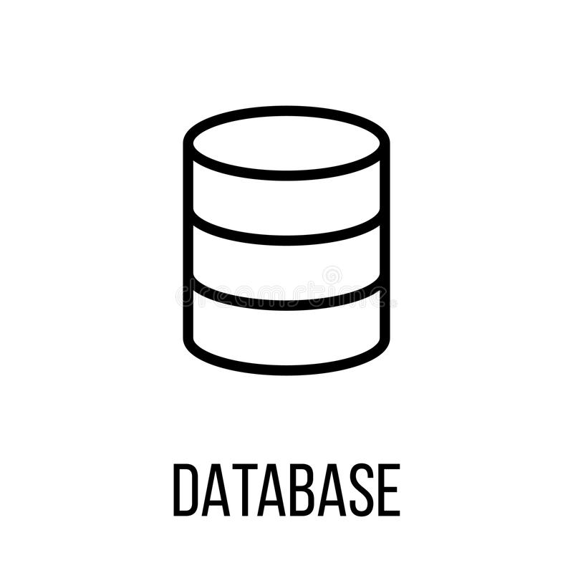
MVC using Servlet & JSP
Service
N-Tier
Servlet
/getPage
Controller
Student-Class
DAO Layer
Client
Model
Pojo
Layout
Service, DAO & Database
Is outside the main MVC
framework
View -> JSP
Student-Profile

Slide 16
JSTL – Java Standard Tag Library
Usage:
Designers are not comfortable with Java code, so it is always much easier to write something like HTML within a Java code
It is easier to maintain, upscale, update the code
We can pass a variable from a Servlet to JSP in RequestDispatcher as request object, in Session as session object, in Cookie as cookie object, and as page object
Whenever you want to use a custom tag to use expression language we need a custom library – that library is called JSTL
Download the JSTL library from google and put it in Web App Libraries, WEB-INF/lib folders
https://jar-download.com/?search_box=jstl-1.2 -> JSTL core library download
mysql-connector-java-8.0.25.jar -> JSTL mySQL connector/J driver library to be copied under WEB-INF/lib folder

